Slide 1
12.4 Kernels as Similarity Measures

Slide 2
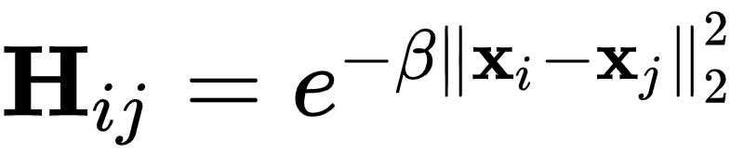
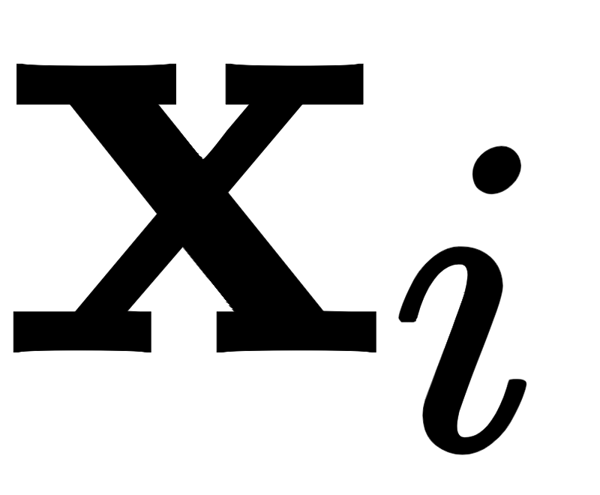
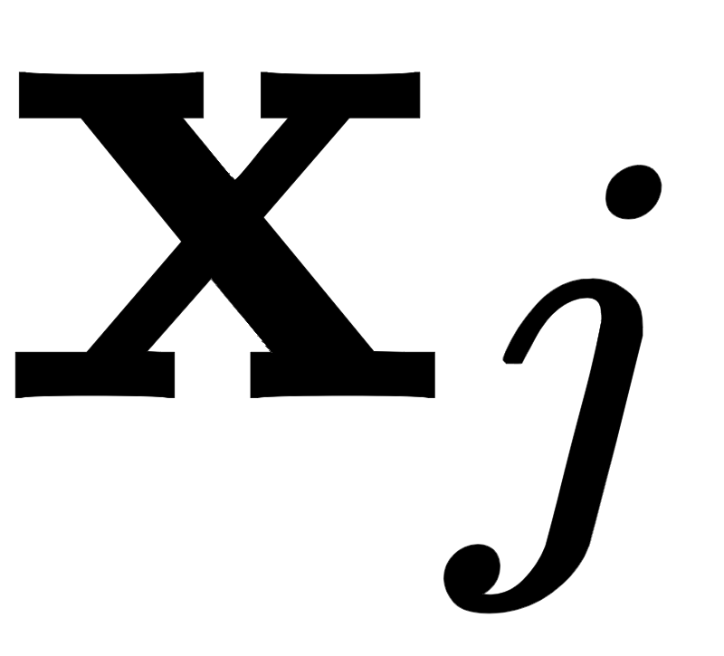
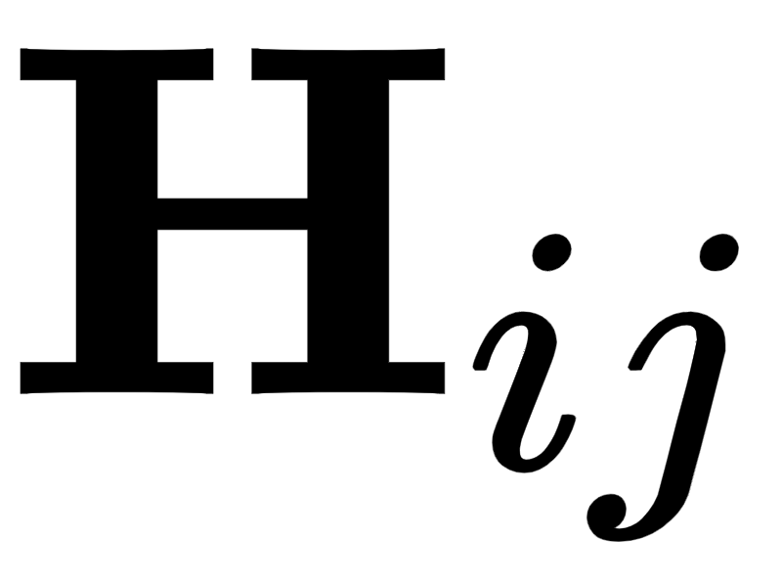
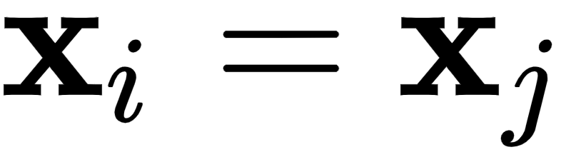
Studying the RBF kernel we can interpret it as a *similarity measure* between the two inputs and
The more similar and are in the input space the larger becomes, attaining the value 1 when
The further apart the two inputs the smaller becomes, attaining 0 when they are infinitely far apart.

Slide 3
The interpretation of kernels as similarity measures also applies to other previously introduced kernels including the polynomial and Fourier kernels, even though these kernels clearly encode similarity in different ways (as shown below).

Slide 4
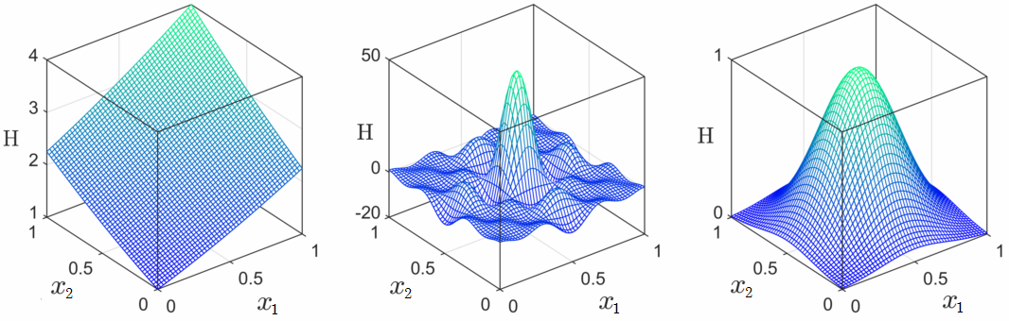
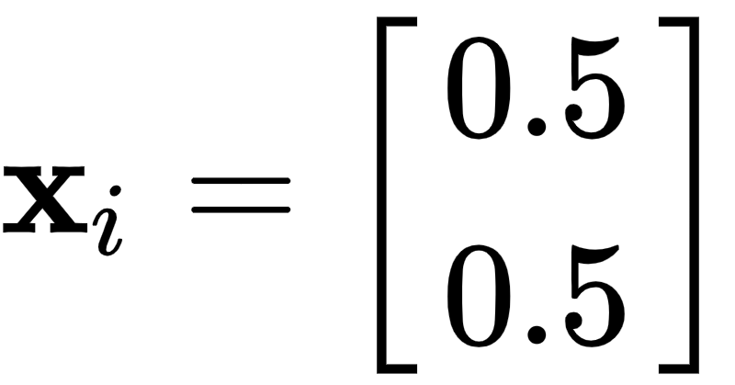
Surfaces generated by a degree 2 polynomial kernel (left), a degree 3 Fourier kernel (middle), and RBF kernel with β = 10 (right) centered at with the surfaces color-coded based on their similarity to

